Slide 1
Digital to Digital Conversion
Notes:
‹#›

Slide 2
Digital-to-Digital Conversion
Representation of digital data using digital signal
Three techniques are used:
Line coding
Block coding
Scrambling

Slide 3
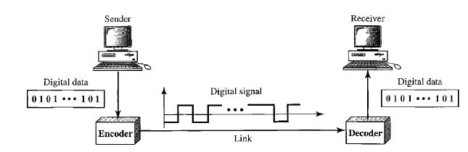
Line Coding
Convert a sequence of bits into a digital signal.

Slide 4
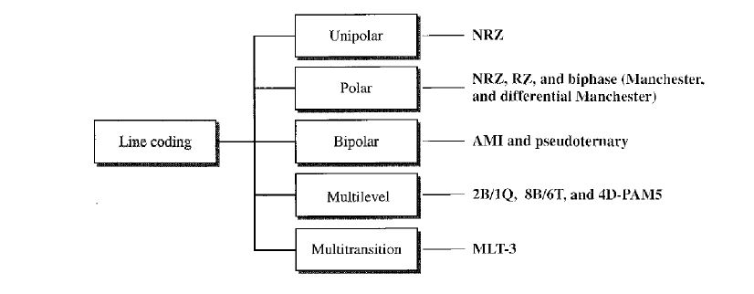
Line Coding Schemes

Slide 5
Unipolar NRZ
If the bit is 1, signal level remains high
If the bit is 0, signal level remains zero

Slide 6
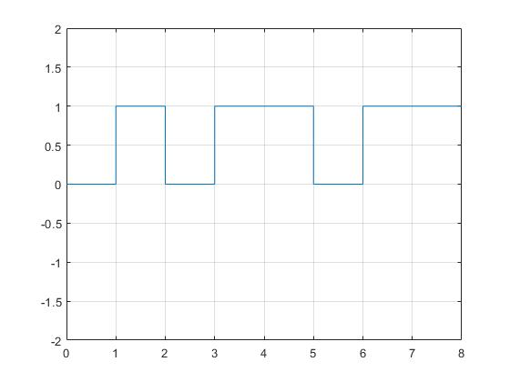
Unipolar NRZ
0 1 0 1 1 0 1 1

Slide 7
Polar RZ
If the bit is 1, half of the bit duration it remains high, later half of the bit duration remains 0
If the bit is 0, half of the bit duration it remains low, later half of the bit duration remains 0

Slide 8
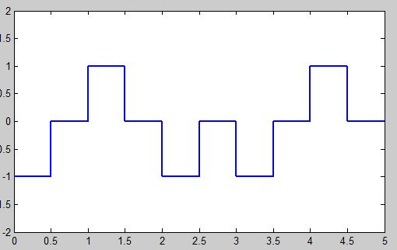
Polar RZ
0 1 0 0 1

Slide 9
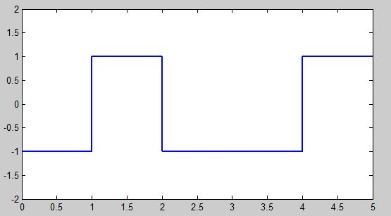
Polar NRZ-L
1 0 1 1 0 (-V for 0 and +V for 1)

Slide 10
Polar Biphase (Manchester)
Combination of RZ and NRZ-L
If the bit is 1, half of the bit duration it remains low, later half of the bit duration remains high
-V → +V
If the bit is 0, half of the bit duration it remains high, later half of the bit duration remains low
+V → -V

Slide 11
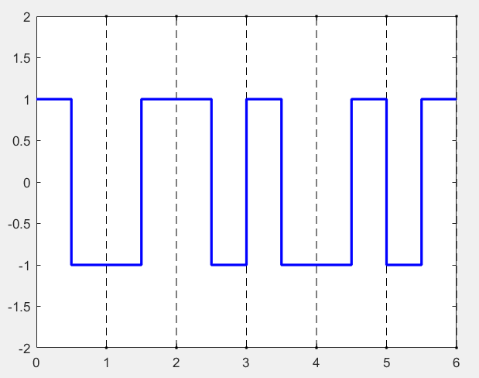
Polar Biphase (Manchester)
0 1 0 0 1 1

Slide 12
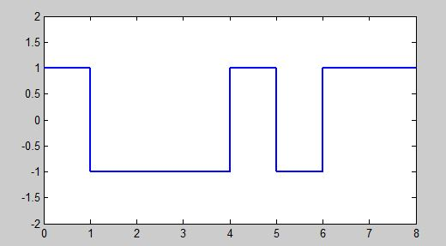
Polar NRZ-I
0 1 0 0 1 1 1 0 (Invert if found next bit is 1)

Slide 13
Polar Biphase (Differential Manchester)
Combination of RZ and NRZ-I
There is always a transition at the middle of
the bit.
If the next bit is 1, no need to invert the direction.
If the next bit is 0, need to invert the direction.

Slide 14
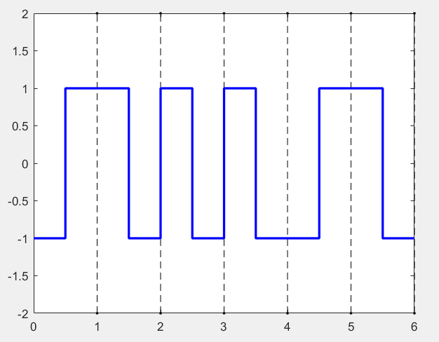
Polar Biphase (Differential Manchester)
0 1 0 0 1 1
Notes:
‹#›

Slide 15
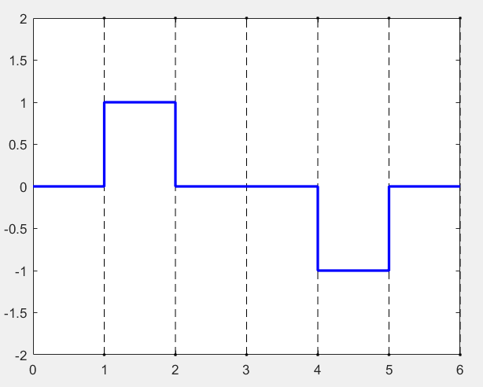
Bipolar AMI (Alternate Mark Inversion)
If the next bit is 1, the voltage will alternate between +v and –v
If the next bit is 0, it will have a 0 voltage.
0 1 0 0 1 0

Slide 16
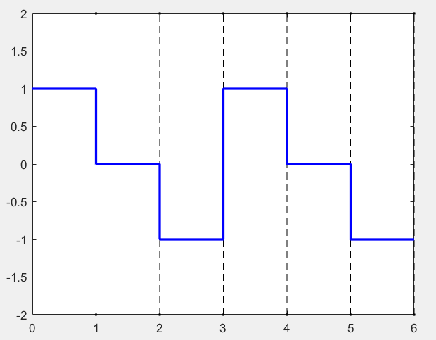
Bipolar Pseudoternary Opposite of AMI
0 1 0 0 1 0

Slide 17
Multitransition MLT-3 (Multiline Transmission)
Till now all the linear encoding techniques followed two rules
If signal have more than two levels then encoding technique can have more than two rules
MLT-3 has three levels (+V,0,-V) and three transition rules

Slide 18
Multitransition MLT-3 (Multiline Transmission)
Transition Rules:
If next bit is 0, no transition
If next bit is 1 and current level is not 0, the next level is 0
If next bit is 1 and current level is 0, the next level is the opposite of the last nonzero level

Slide 19
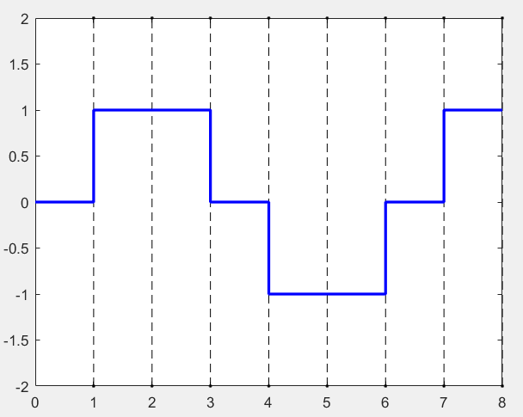
Multitransition MLT-3 (Multiline Transmission)
0 1 0 1 1 0 1 1

Slide 20
Thank You…
Notes:
‹#›

